Slide 1

Data Analysis and Visualization with Python
This project explores the power of Python libraries for data analysis and visualization. It focuses on NumPy, Pandas, Matplotlib, and Seaborn, which offer a comprehensive toolkit for working with data.

Slide 2

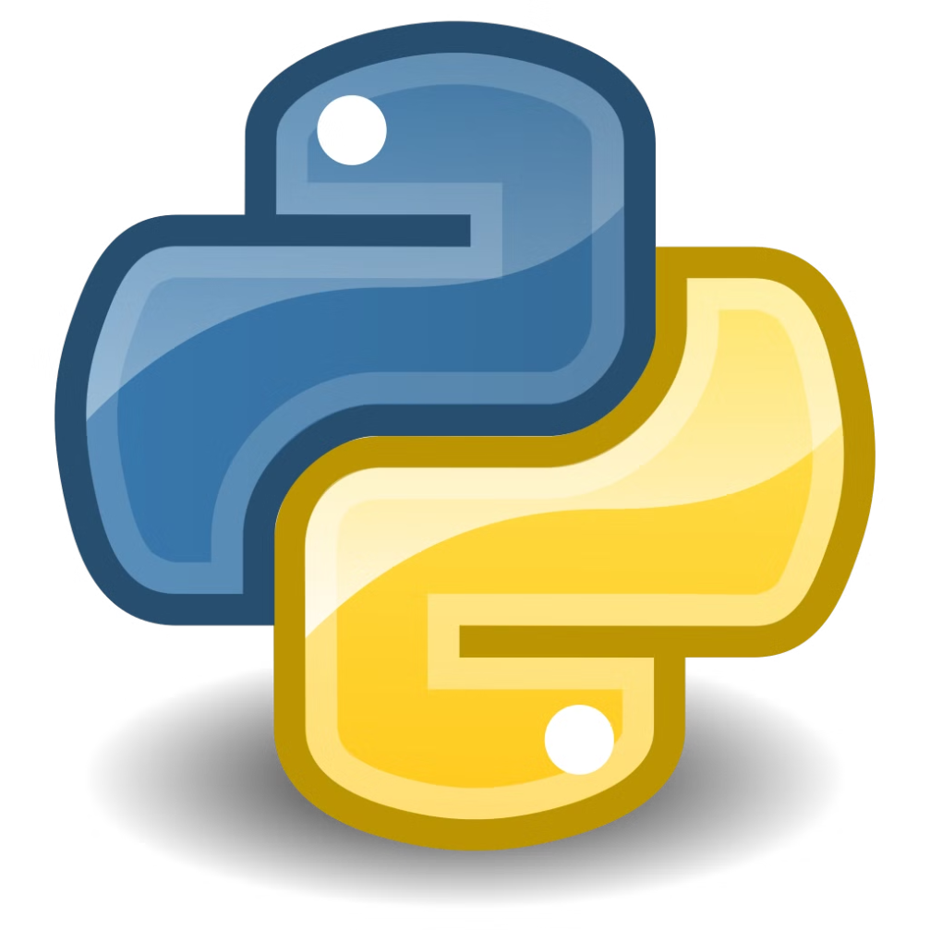
Introduction to Python Data Analysis Libraries
1
NumPy
2
Pandas
Provides efficient numerical operations, array manipulation, and mathematical functions.
Offers powerful data structures (DataFrames and Series) for data manipulation, cleaning, and analysis.
3
Matplotlib
4
Seaborn
A versatile plotting library that supports creating a wide range of static, animated, and interactive visualizations.
Builds on Matplotlib to provide high-level statistical data visualizations, enhancing the aesthetics and insights of plots.

Slide 3
Working with NumPy for Numerical Operations
Arrays
Mathematical Functions
Broadcasting
NumPy's ndarray provides efficient multi-dimensional arrays for numerical computations.
Offers a wide range of mathematical functions for statistical analysis, linear algebra, and more.
Allows operations on arrays of different shapes, simplifying calculations and reducing code complexity.

Slide 4
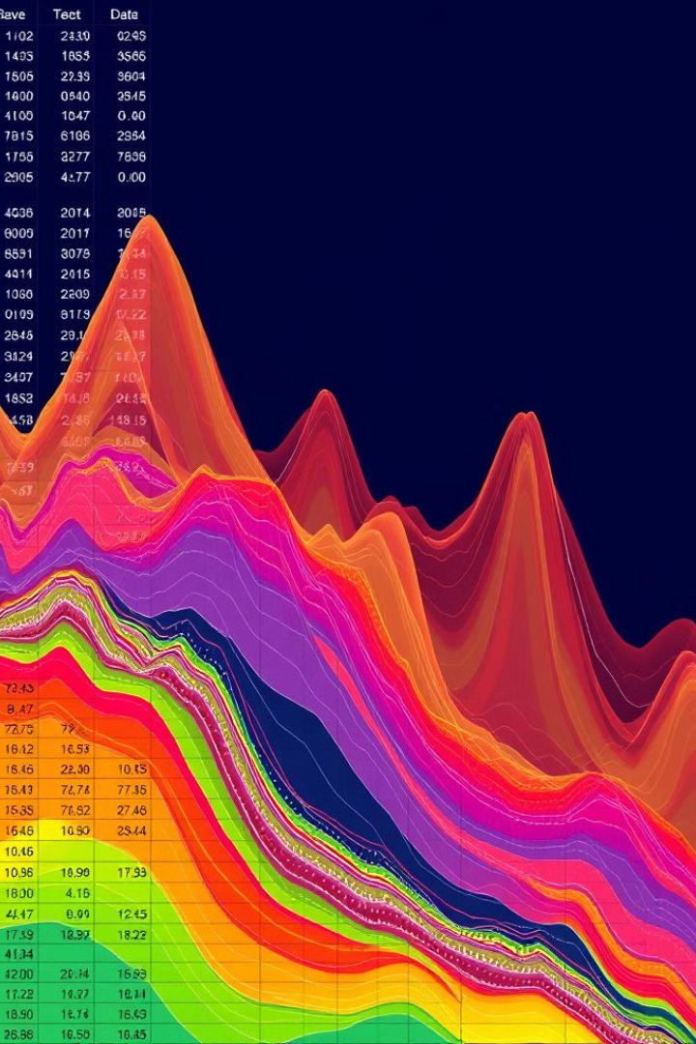
Pandas for Data Manipulation and Cleaning
1
Data Loading
Pandas can read data from various file formats (CSV, Excel, JSON) and load it into DataFrames.
2
Data Cleaning
Handles missing values, duplicates, and inconsistent data types, ensuring data quality for analysis.
3
Data Transformation
Facilitates data manipulation, filtering, sorting, aggregation, and grouping for insightful analysis.

Slide 5

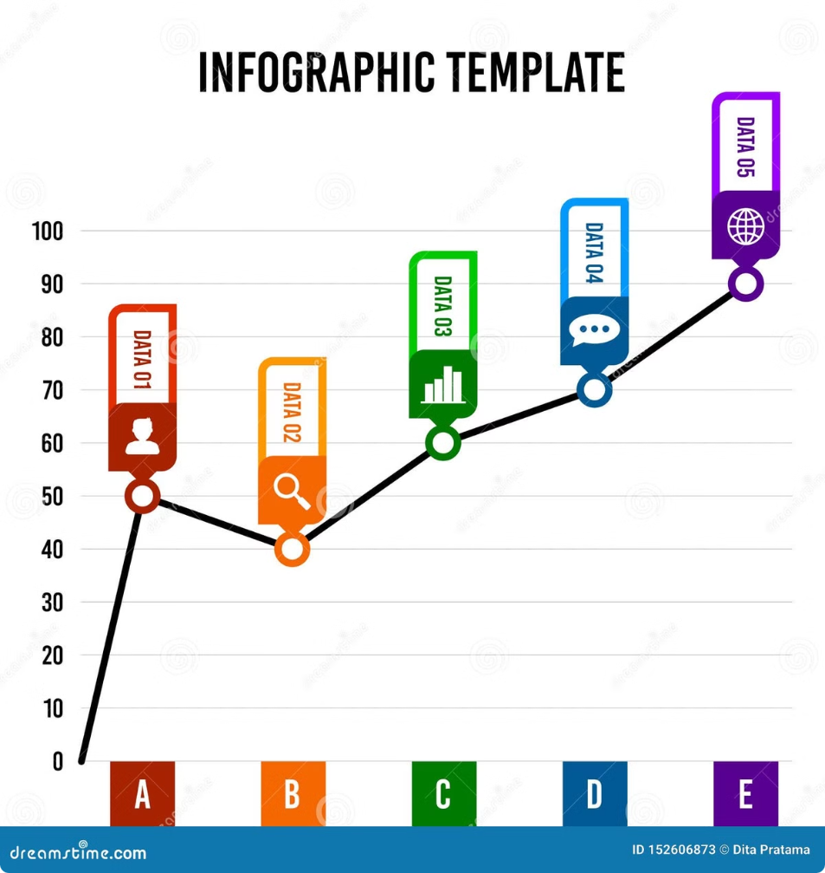
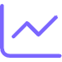
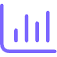


Visualizing Data with Matplotlib
Line Charts
Bar Charts
Illustrate trends over time or relationships between variables.
Compare categorical data or illustrate the distribution of values.
Scatter Plots
Histograms
Show the relationship between two numerical variables, revealing correlations and patterns.
Represent the distribution of numerical data, visualizing frequencies and central tendencies.

Slide 6

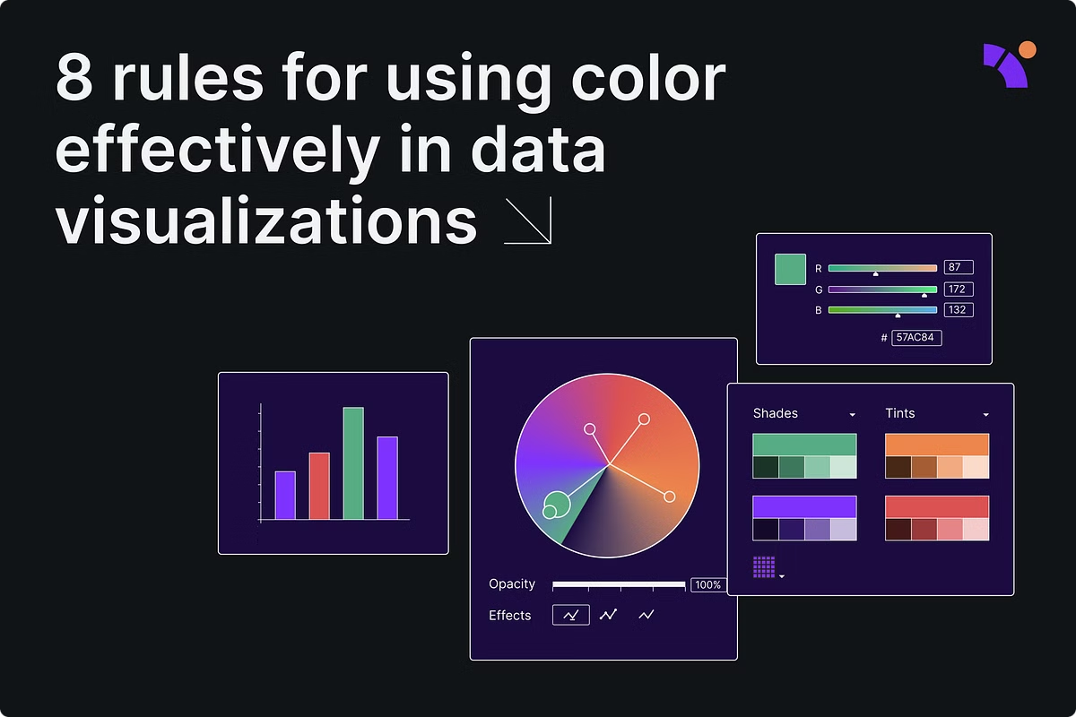
Advanced Data Visualization with Seaborn
Statistical Plots
Themes and Styles
Seaborn provides high-level functions for creating statistical visualizations, simplifying the process and improving clarity.
Seaborn offers built-in themes and styles for aesthetically pleasing and informative visualizations.
Joint Plots
Pair Plots
Visualizes the relationship between two variables, including a scatter plot, marginal distributions, and a regression line.
Creates a matrix of scatter plots showing the relationship between all pairs of variables in a dataset.

Slide 7
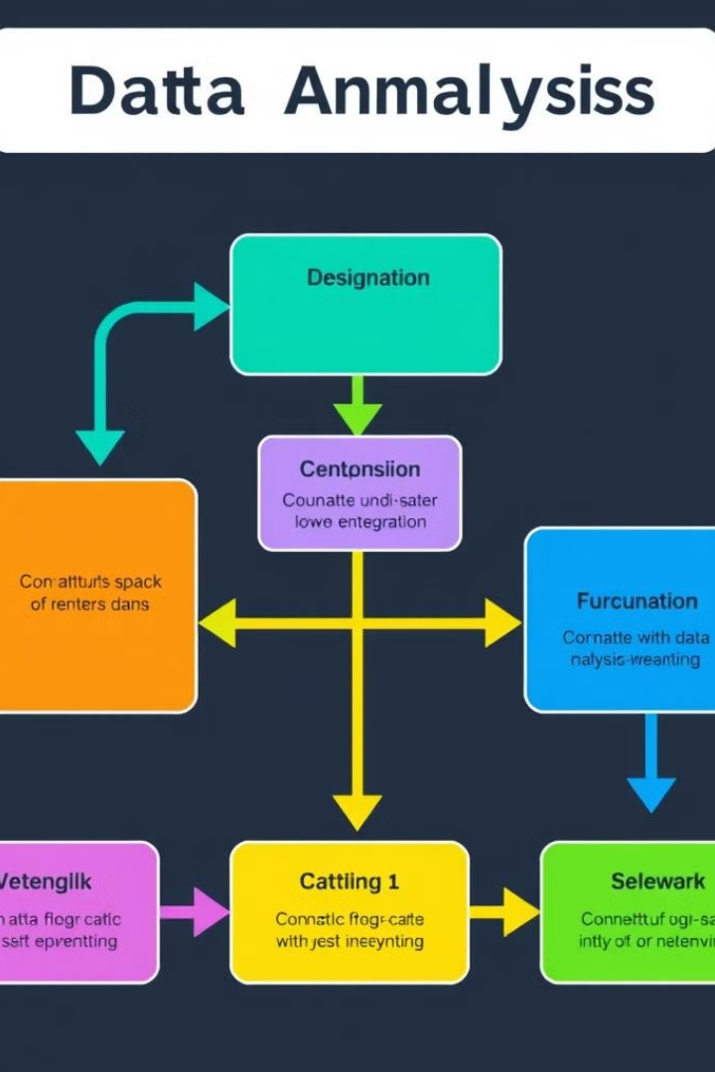



Combining Libraries for End-to-End Analysis
Data Loading and Cleaning
Pandas is used for data loading, handling missing values, and preparing data for analysis.
Data Exploration and Analysis
NumPy and Pandas are employed for calculations, data aggregation, and exploring relationships between variables.
Visualization
Matplotlib and Seaborn create insightful visualizations that communicate findings and trends effectively.

Slide 8
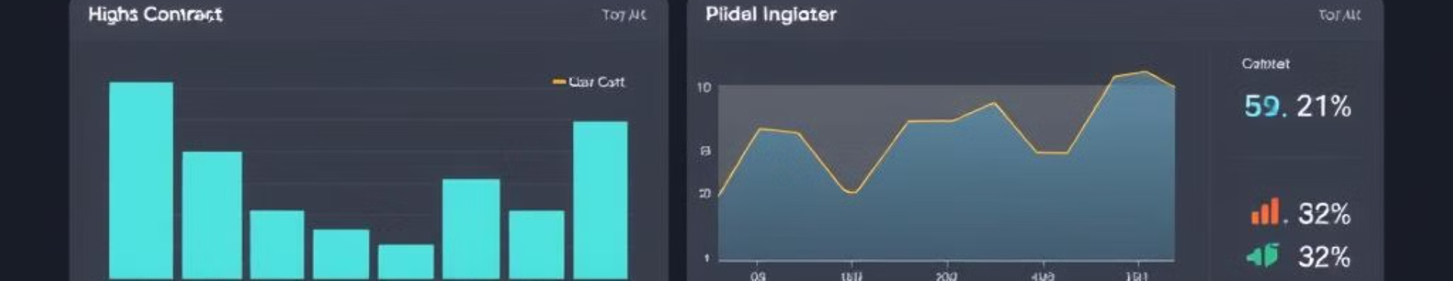
Practical Use Cases and Applications
Business Analytics
Sales trends, customer segmentation, market analysis
Financial Analysis
Stock market trends, risk assessment, portfolio optimization
Scientific Research
Data analysis, visualization of experimental results, hypothesis testing

Slide 9
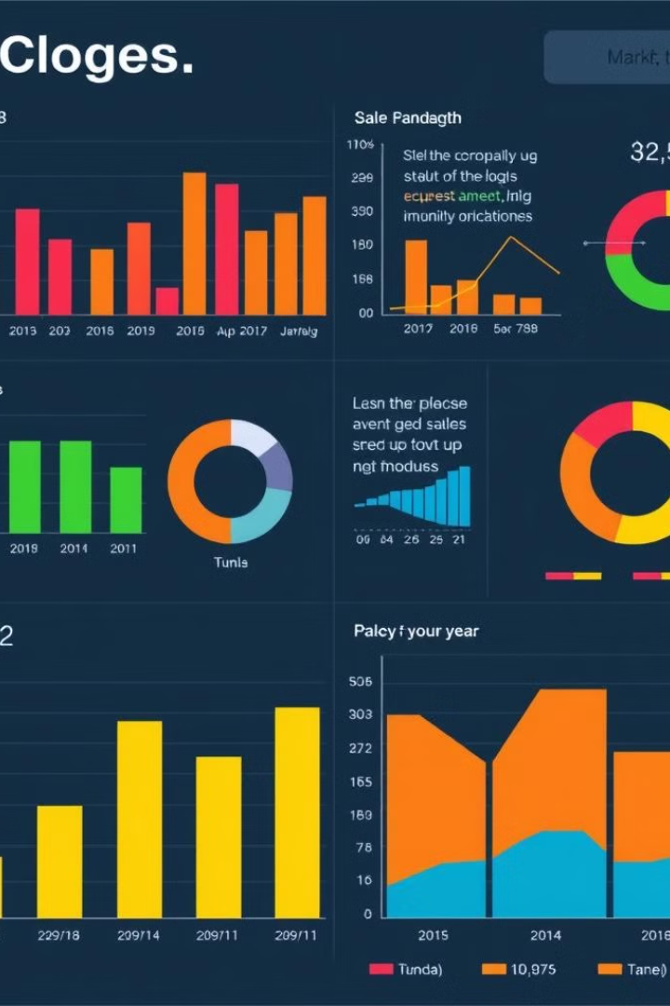
Conclusion and Key Takeaways
This project demonstrated how to use NumPy, Pandas, Matplotlib, and Seaborn to analyze and visualize data in Python. These libraries provide a powerful toolkit for working with data effectively, from loading and cleaning to exploration and visualization. They are essential tools for data scientists, analysts, and researchers in various fields.

